Slide 1
French Personal tax matters
Wednesday 24 November 2021

Slide 2
French tax return
French Tax Year runs from 1 January to 31 December, where the UK Tax Year runs from 6 April to 5 April of the following year.
Watch out when you have to provide a proof of a UK generated income to the French Tax Authorities, P60’s and Rental Accounts prepared for the UK tax return purpose. Those can cause confusion!
Better provide payslips, bank statements or accountants confirmation letter.
Consists of various forms, 2042 is the main return, 2047 for declaring the non-French income, 2044 for rental income, 2074 for capital gains and various others.

Slide 3
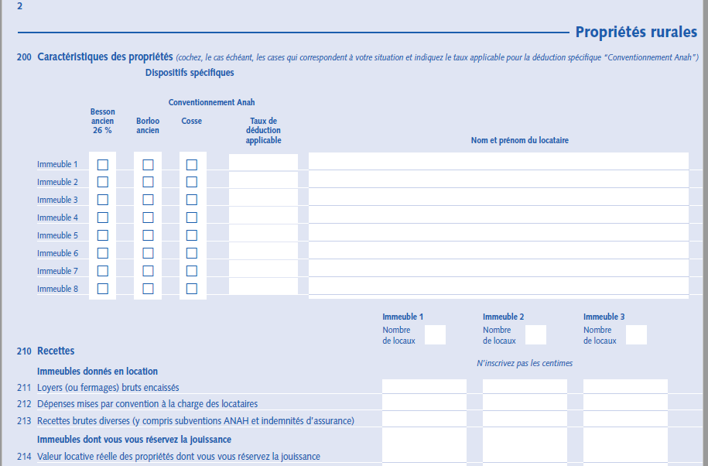
French tax return
2044
2042
2047

Slide 4
French Income Tax Rates
Income tax rates in France in 2021 are the following:
Up to €10,084: 0%
€10,085–€25,710: 11%
€25,711–€73,516: 30%
€73,517–€158,222: 41%
€158,223+: 45%
Taxes are paid as a household and not on an Individual basis.
Parts
In general each spouse has 1 part, first 2 kids, ½ part each and from 3rd kid 1 part each

Slide 5
Employment Income
French earned salary is taxed in France as normal – special case the impatriate regime.
Non-French Salary depends on the appropriate Tax Treaty.
Under the Franco-British Tax Treaty if duties are performed in the UK, the salary is taxed only in the UK.
This still needs to be declared in France but it is not taxed.
It will however be taken into account to determine the tax rates that will apply to the taxable income.

Slide 6
Pension Income
French earned Pension is taxed in France as normal
UK State Pension is taxed in France as normal
UK Civil Servants Pension (NHS, Teachers Pension, Local Authority pension etc) is taxed only in the UK. In France it still needs to be declared but it is not taxed, although it will be taken into account to determine the tax rates that will apply to the taxable income.

Slide 7
One off Lump sum payment from Private Pension Scheme such as SIPP’s and QROP’s
Option to choose the 7.50% rate of the 90% of the capital received.
Watch out conditions – in French:
« Le versement du capital n’est pas fractionné ; »
« Les cotisations versées pendant la phase de constitution des droits, y compris le cas échéant par l’employeur, étaient déductibles du revenu imposable. »

Slide 8
Financial Products Income (Bank Interest, Dividends, Capital Gains)
Flat Tax 30% option (PFU) – 12.80% Income Tax + 17.20% Social Charges
Or
Taxed at your tax rate bands according to overall income – this is more interested if your income tax rate is below 12.80%.

Slide 9
UK Rental Income
This income is not taxable in France as long as it was taxed in the UK.
Taxed in the UK implies filing a UK tax return - It is taken into account to
determine the tax rate of any other sources of income.

Slide 10
French Rental Income – Non Furnished
You can choose the:
Regime Reel – once chosen cannot change to the regime Micro only after 3 years - Filing a 2044 form
Or
Micro Foncier – Income less than 15K€ per year, 30% reduction - No need to file a 2044 form, only in Box 4BE of 2042 form.

Slide 11
French Furnished Lettings – Non Professionals - LMNP
Regime Réel
Micro – Income less than 72,600€ per year, 50% reduction

Slide 12
French Rental Income received by a non- French Tax Resident
Social Charges at 17.20% + Income Tax at the rate of 20% (up to 25,710€)
Or
30% (income above 25,711€) in addition to the Social Charges.

Slide 13
Disposal of a UK property
The capital gain (using the French CGT rules – reducing year by year over the duration of 30 years) generated on the disposal of a UK property from a French Tax resident is declared in box 3VZ. The gain will be taken into account to determine the tax rate of the other sources of income.
The gain itself is not taxed in France.

Slide 14
Non French Bank Accounts and Financial Products
Any overseas bank accounts, held outside of France, ie.
Current accounts, savings accounts, paypal accounts, currency transfer accounts, children’s bank accounts, premium bonds, private pension schemes, life insurance, investments accounts, digital currencies and credit cards, must be declared in forms 3916 and 3916 bis.
Failure to do so, could amount to a minimum penalty of €1,500 for each account not declared or up to 5% of the funds turned in the account during the year – the greatest amount

Slide 15
Some items which can help to reduce your tax liability
Donations – payments to charities within France and Europe can be declared in box 7UF on form 2042.
The total amount of donations made, is entered here and you will receive 66% of the value as a tax credit. Please ensure that you keep the attestations of donation as proof.

Slide 16
Some items which can help to reduce your tax liability
If you employ home help, ie. a nanny or cleaner and the payments are declared via the CESU, then you can declare the amount which is shown on the annual CESU attestation, in box 7DB, on form 2042.
Again, you will receive 50% Tax Credit of the total amount paid (including Social Charges), up to €15,000 per year, or €18,000 for a nanny.
Private tutors can also be included, in the €15,000 per year, as long as there is an annual attestation for the company/individual used or copies of the invoices received.

Slide 17
Some items which can help to reduce your tax liability
Payments made to a crèche or centre loisirs for childcare, can also be declared to receive a 50% tax credit up to the cost value of €2,300 per child – max. tax Credit 1,150€ per child. These amounts are entered in box 7GA, 7GB and 7GC, depending on the number of children you have under the age of 6 years old.
Small repairs and maintenance around the house can be declared on form 2042, up to a value of €500. These need to be entered in box 7DB.
For energy efficiency improvements in your principal home in France, you may be eligible for a tax credit, but this is based on the type of work done and also your income bracket.

Slide 18
Brexit Effect
Income Tax rules are determined by the Tax Treaty between the UK and France, however you might not be pleased to hear that donations to British charities do not longer qualify for a Tax Credit in France.
You receive a Tax Credit only if the donation was paid to a French or an EU charity.
« Vous avez effectué un don au profit d'organismes agréés dont le siège est situé dans un Etat membre de l'Union Européenne ou dans un Etat partie à l'Espace économique européen ayant conclu avec la France une convention fiscale d'assistance administrative en vue de lutter contre la fraude et l'évasion fiscales ».

Slide 19
Example 1 :
Income Summary 2020
Spouse 1 : €50,000
Spouse 2 : €100,000
French Rental Income : €10,000
Total Income €160,000
No of kids 3
Each spouse is 1 part : 2
First 2 kinds is ½ part : 1
From the 3rd kind and
onwards an additional 1 part : 1
Total Parts 4
Income for 4 parts – divided the total income by 4 : € 40,000
Band rates | 2020
Up to €10,084: 0% | 10,084 | x 0% | -
€10,085–€25,710: 11% | 15,626 | x 11% | 1,718.86
€25,711–€73,516: 30% | 14,290 | x 30% | 4,287.00
€73,517–€158,222: 41%
€158,223+: 45%
Total tax for 1 part : 6,005.86
for 4 parts : 24,023.44
1,720.00
Total income Tax and 25,743.44
social charges
Social Charges (CSG-CRDS)
on Rental Income at 17.20%

Slide 20
Example 2 :
Income Summary 2020
Spouse 1 : €50,000
Spouse 2 : €100,000
UK Rental Income : €10,000
Total Income €160,000
No of kids 3
Each spouse is 1 part : 2
First 2 kinds is ½ part : 1
From the 3rd kind and
onwards an additional 1 part : 1
Total Parts 4
Income for 4 parts – divided the total income by 4 : € 40,000
Band rates | 2020
Up to €10,084: 0% | 10,084 | x 0% | -
€10,085–€25,710: 11% | 15,626 | x 11% | 1,718.86
€25,711–€73,516: 30% | 14,290 | x 30% | 4,287.00
€73,517–€158,222: 41%
€158,223+: 45%
Total tax for 1 part : 6,005.86
for 4 parts TTBC : 24,023.44
-1,501.47
Total income Tax 22,521.98
Less : Tax Credit on UK income
Effective Tax Rate - TTBC / Total Income 15.01%

Slide 21
Example 3 :
Income Summary 2020
Spouse 1: UK State Penion €7,000
Spouse 1: NHS Pension €15,000
Spouse 2 : UK State Pension €7,000
UK Rental Income : €10,000
Total Income €39,000
No of kids 0
Total Parts 2
Income for 2 parts – divided the total income by 2 : € 19,500
Band rates | 2020
Up to €10,084: 0% | 10,084 | x 0% | -
€10,085–€25,710: 11% | 9,416 | x 11% | 1,035.76
€25,711–€73,516: 30% | - | x 30% | -
€73,517–€158,222: 41%
€158,223+: 45%
Total tax for 1 part : 1,035.76
for 2 parts TTBC : 2,071.62
-1,327.90
Total income Tax 743.62
Less : Tax Credit on UK Income
Effective Tax Rate - TTBC / Total Income 5.31%

Slide 22
Thank you for your participation
Sakis Elisseou FCCA
sakis@nle-accounting.com

